Slide 1
Choosing more secure open source packages: Lessons from the Real world
Seagl 11/09/2018
Michaela (Miki) Demeter

Slide 2
How well do you know what’s inside your projects?
Notes:
only by examining the components in detail will you know what is inside your projects

Slide 3
As A Security Professional You are expected to know what is in your product
Notes:
Sometimes as a security professional you are not aware of a product until it is ready for release and the team contacts you to say they have an issue.
Today teams are beginning to be more proactive instead of reactive so hopefully the security team is brought in early during architecture discussions.
I hope this presentation enables you to be more proactive.

Slide 4
“I am involved in examining open source projects and third party components for 'known good' development practices.”
Notes:
I originally was a Security Champion in Intel's Open Source Technology Center (OTC). This was a full time job and when the Security Development Lifecycle was expanded to cover all software at Intel, well let's say it was a nightmare. No one truly understood how much open source software was being used but our small team understood all too well. I moved to the Corporate team responsible for governance, training and SDL. This is important because in order to work across Business Units you need to have management backing.

Slide 5
There’s a big difference between good, community-supported open source software and random code found on the internet.
Notes:
I am leaving these original notes from one of my co-workers in because they are exactly what I was stating in the previous slide notes.
"So, let’s be honest, I thought the team at SeCoE that made this policy change was making a mistake. I mean, this was better than doing full SDL on every single bit of code you used, but surely our engineers were good enough at determining what packages were good and which were terrible? Turns out, no, we’re not."

Slide 6
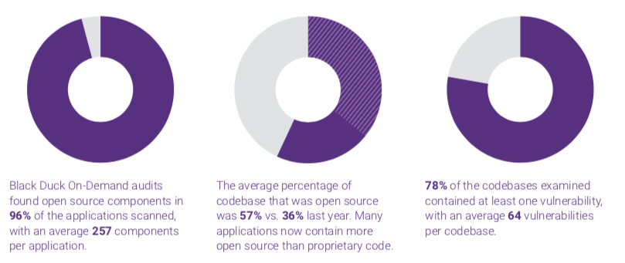
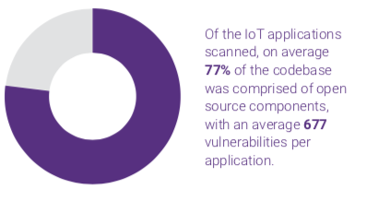
Yikes
Source:
2018 Open REPORT Source Security and Risk Analysis
Synopsys Center for Open Source Research & Innovation
Notes:
This is absolutely not good news at all. In fact it shows that as more open source software is used we are getting worse at securing it.
Source: 2018 Open REPORT Source Security and Risk Analysis
Synopsys Center for Open Source Research & Innovation

Slide 7
I want to enable you to ship more secure better quality open source software.
Notes:
By giving you some real world examples and a few tools to use I hope to help instill a security first attitude. This enables you to make good choice up front rather than reacting to issues after releasing the software.

Slide 8
How do I choose good Open Source Packages?
Notes:
I am not here to tell you how to choose open source. Just here to help you make better choices. So I will explain my process for looking at packages because "GOOD" is such a subjective term.

Slide 9
How do I choose SeCURE Open Source Packages?
Notes:
I will be the first to say you can not ever be sure the open source software you have chosen to incorporate into a project is secure. But by taking some time early in the project you can minimize your risk to security issues during or after your project has been released.

Slide 10
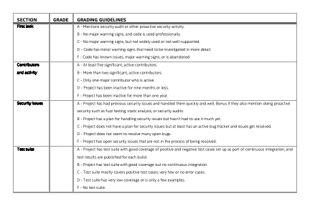
Notes:
This is so important I moved it to the beginning of the presentation just to make sure we get to talk about it first..
Using this grading card won't guarantee that the team has made a good choice, but it will certainly lower the risk associated with the choices a project team may make.

Slide 11
Key Takeaways
Take a look (Are there red Flags?) Really Read it
Check for the number of contributors & activity
Does the project handle security issues
Look for a test suite (make sure it does something)
Be aware Trust nothing
Notes:
So here’s the list all on one slide. It might take some time the first few times you run through this list. BUT if you do this every time and take a closer look at everything with a some amount of scrutiny you will lower the projects overall risk exposure.

Slide 12
Step 1: Take a look first look
https://clipartxtras.com/categories/view/24dc10f8c0e963e9168b2fcab20d51d21feb8bff/take-a-look-clipart.html
Notes:
The very first thing we want to do is really take a close look at what we want to use.

Slide 13
Some Key Questions for a First Look at a New Package
read the readme,,or any other readily available introductory information?
Does this code appear to be held to good software development standards?
Is this code used professionally or is it a hobby project?
Are there any signs that there are known issues with this code?
Does this code only solve one use case or is it robust enough for other use cases?
Is this code active or an archive essentially abandoned?
Look for warning signs.

Slide 14
Let’s look at some warning signs
http://chittagongit.com/icon/high-risk-icon-21.html
Notes:
So let us see how you can add risk to your project when you don't look at what you are adding. These are all in the real world examples and I am not naming and shaming. These developers have given you the information to make an informed decision on whether you want your companies reputation and name brand resting on this code.

Slide 15
Even the developers say to use something else…
https://github.com/01org/IntelRackScaleArchitecture
“use TweetNaCl.js (a TweetNaCl port to JavaScript) rather than this implementation, which is more likely to perform in constant time and has likely seen more eyes for review/audits.”
*****************DISCLAIMER******************
This code is reference software only and is not feature complete. It should not be used in commercial products at this time. Intel makes no claims for the quality or completeness of this code.
https://github.com/andi506/crypto-js
Notes:
Many times developers put out example code or proof of concept code and most (not all) tell you up front. The key here is DON"T put this code into production environments.

Slide 16
nice to know!!!!
“I didn’t write this code but I like it.”
https://github.com/kbranigan/cJSON
Notes:
https://github.com/kbranigan/cJSON
This really should be a very big red flag. Where did they get it from? Is the license correct or was it changed? The main take away here if they didn't write it move along and look somewhere else. It is not worth the headaches.

Slide 17
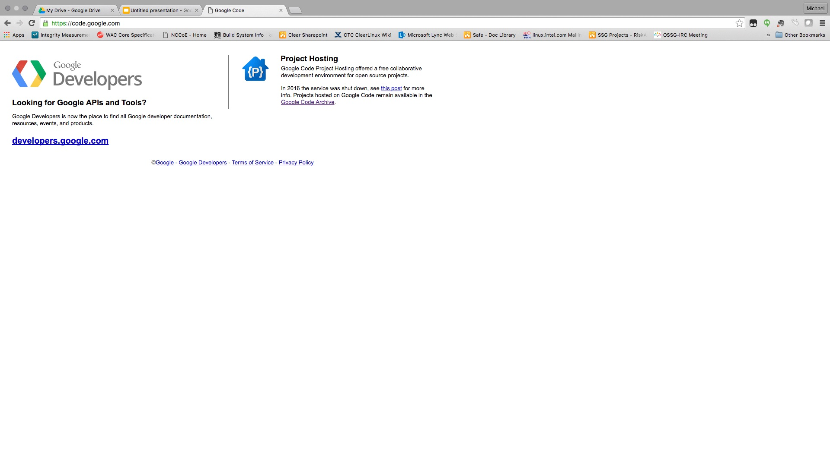
Shut down in January 2016
Notes:
In 2016 code.google.com was shut down. Many projects were moved elsewhere and are still maintained find those repositories, don't use anything here.
Archived code is dead code... Don't use it. No one is looking at it or fixing issues..

Slide 18
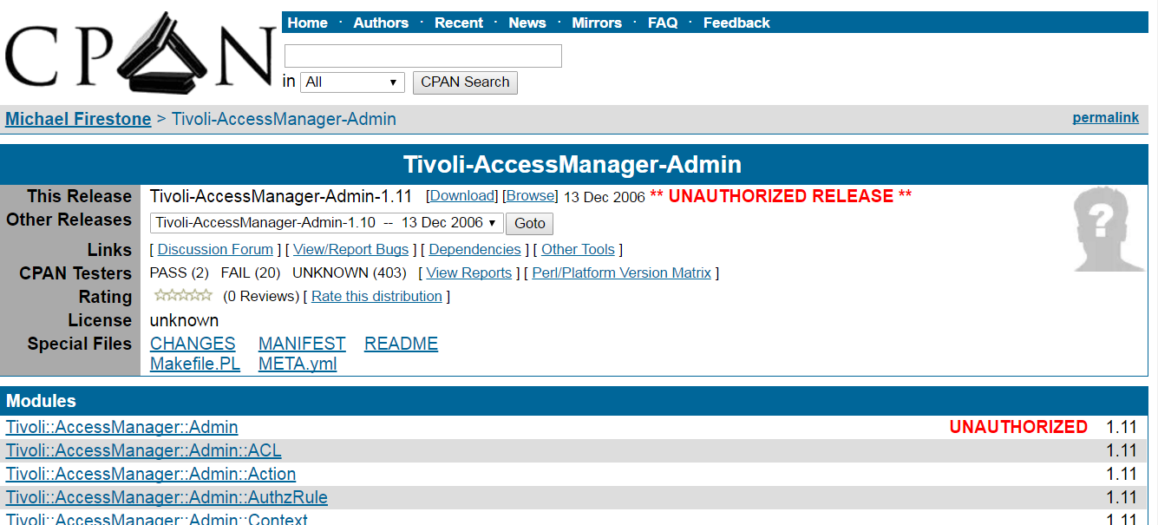
Does anyone really look to see what this means?
Notes:
ThisFrom CPAN:
A co-maintainer uploaded a new release, but because of an oversight wasn’t granted permission on one of the modules. This often happens with distributions that have a different release manager each cycle.
Someone without co-maintainer permissions forked the distribution and uploaded it.
An author makes a new release with a new namespace without realizing that namespace is taken by another author.

Slide 19

https://www.gograph.com/vector-clip-art/nope.html
Notes:
Provenance is everything. Where did it come from and can you trust it.

Slide 20
“CryptoJS is a project that I enjoy and work on in my spare time, but unfortunately my 9-to-5 hasn't left me with as much free time as it used to. I'd still like to continue improving it in the future, but I can't say when that will be.”
“opencsv was developed in a couple of hours”
http://opencsv.sourceforge.net/
https://code.google.com/archive/p/crypto-js/
Notes:
Two examples of developers that are telling you they don't necessarily do this for a living and maintenance will be less than optimal if at all. If a vulnerability is discovered can you trust that it would get fixed in a timely manner.. Probably better to look elsewhere. NOTE: The statement on opencsv would not be found without reading to the very end of the description to "Who maintains opencsv?"

Slide 21

Notes:
Don't hide away from bringing these issues forward, finding these things out after the fact is far worse than making it known this has huge implications.

Slide 22
“[This code is] slower and more subjective to side-channel attacks by nature”
http://www.literatecode.com/aes256
Notes:
Someone searching for a fast implementation of aes wanted to use this. The author tells you it was built to solve one use case and also goes on to tell you it is subject to attack vectors. I am not sure I would want to rest my reputation on adding this to a project.

Slide 23
“cJSON aims to be the dumbest possible parser that you can get your job done with. ”
https://github.com/kbranigan/cJSON/commit/730209a718cc9bada631cea136d13017752720f5
Notes:
When it comes to parsers the minute someone suggests writing their own just say NOPE. When you see key words like faster, lightweight, small footprint realize that something had to be given up to gain those attributes.

Slide 24
Step 2: Check the contributors and community contributors & Activity
Notes:
Github has some great metrics that can really help you out.

Slide 25
Key questions about Contributors
How many active and significant contributors?
Is this code actively maintained or is it abandoned?
How many pull requests & checkins in the past year?
Are issues fixed and released on a regular basis?
Who signs off on code reviews?
Is there more than one maintainer?
Notes:
Active contributors are good but it the significant contributors that makes a big difference. When was the last time anything was checked in or when was the last release? How many outstanding pull requests? Are there discussions taking place? How many accepted pull requests?Does the project fix issues and issue new releases? It does no one any good if there is a fix checked in but no release. Do code reviews happen? Is it one person or a group effort? More eyes is better. Than of course is there more than one maintainer. More maintainers the better.

Slide 26
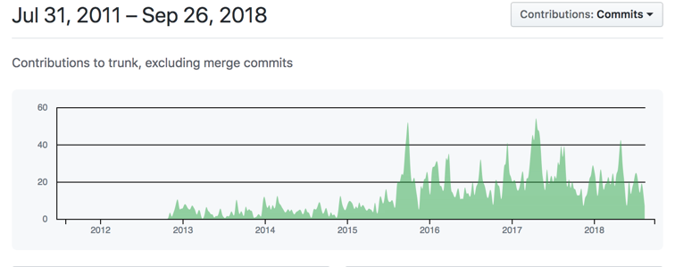
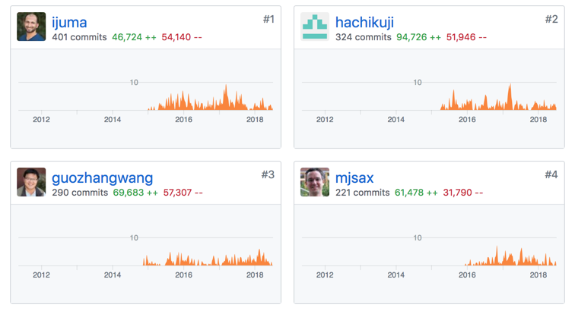
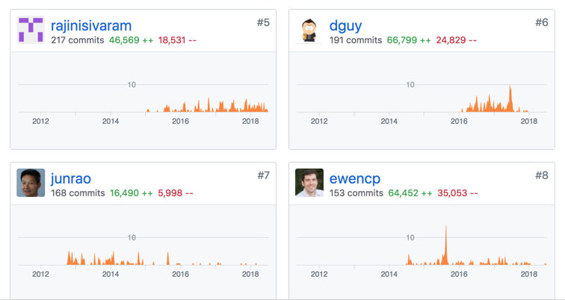
Good example: many active contributors
Notes:
So here’s an example of an active project. Apache Kafka. Many Active and significant contributors

Slide 27
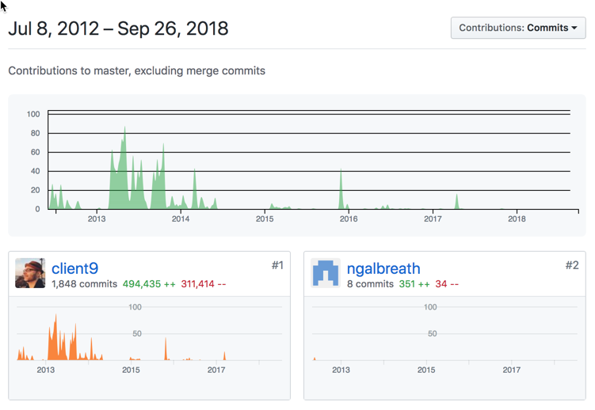
A good example of one you might want to skip: one significant contributor and not recently active
Notes:
There were 18 contributors, 14 submitted significantly < 50 lines. Almost all of the code was written by one contributor and has had no activity since early 2017. Since it is a parser I would probably look somewhere else.

Slide 28
Step 3: Check how they handle vulnerabilities handle security issues

Slide 29
Key Questions about Handling Security Issues
Is there a clear way to report security vulnerabilities?
Is there evidence that vulnerabilities are fixed in a timely manner?
Is there any explanation of what happens when a security issue is reported?
Notes:
An ideal procedure should involve a way to keep the vulnerability secret until a fix is found. Typical good solutions: send email to a special security mailing list. Bug tracker with special “security” flag. If there’s no way to report security issues specifically, assume they have not thought about it (and this is a bad sign).

Slide 30
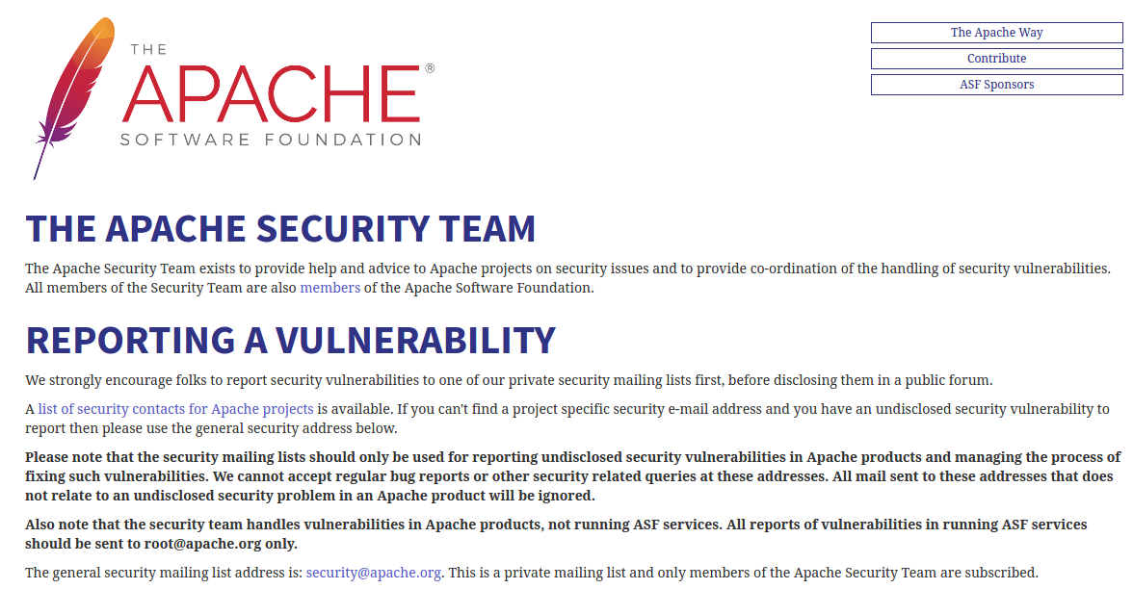
Great Example:
https://www.apache.org/security/
Notes:
So one of the best examples is Apache. They have a very clear vulnerability process that we know from experience that they follow, and it applies to all the active projects under the Apache banner.

Slide 31
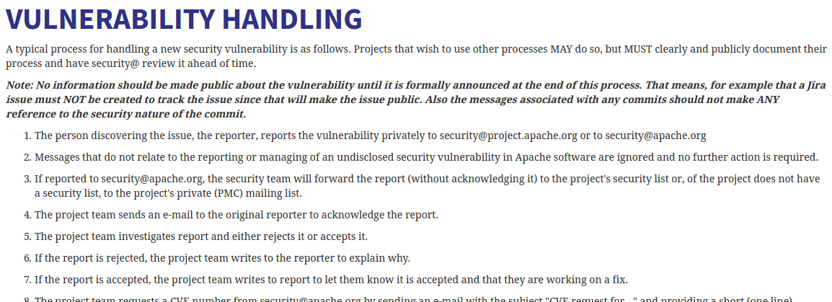
https://www.apache.org/security/committers.html
Written policy
Notes:
They even go one step further to let people know what to expect when they report a bug, so you can tell if they’re handling things by their process pretty easily.

Slide 32
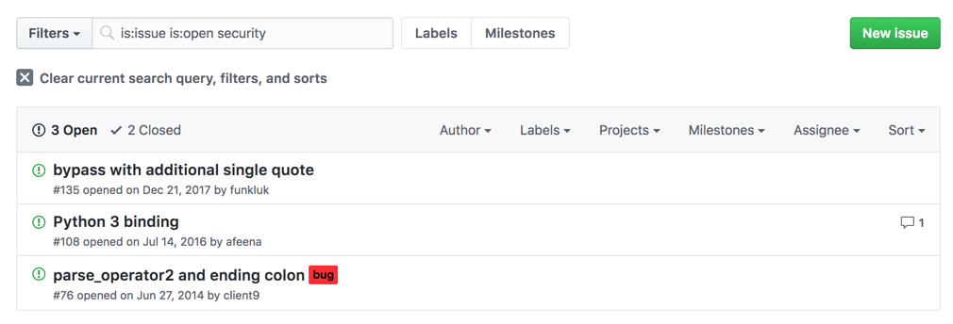
Look for unfixed security bugs
Notes:
Unfixed security bugs will come back to haunt you someday sometime. Better to know up front and choose something totally different.

Slide 33
No known vulnerabilities does not equal security
Notes:
Just because there are no known vulnerabilities does not mean that it is safe to use. In fact it means quite the opposite. You should probably scrutinize it even more because it more than likely means no one is really looking at it. It does not matter how well looked at it will have vulnerabilities and you need to be prepared to remediate them.

Slide 34
Why?
CVEs (Common Vulnerabilities and Exposures) aren’t easy to file,
This can be a sign of a lack of security expertise
many times no one is looking
sometimes issues are actively rejected or hidden
how Project Teams react to known vulnerabilities will help you to evaluate their security processes.

Slide 35
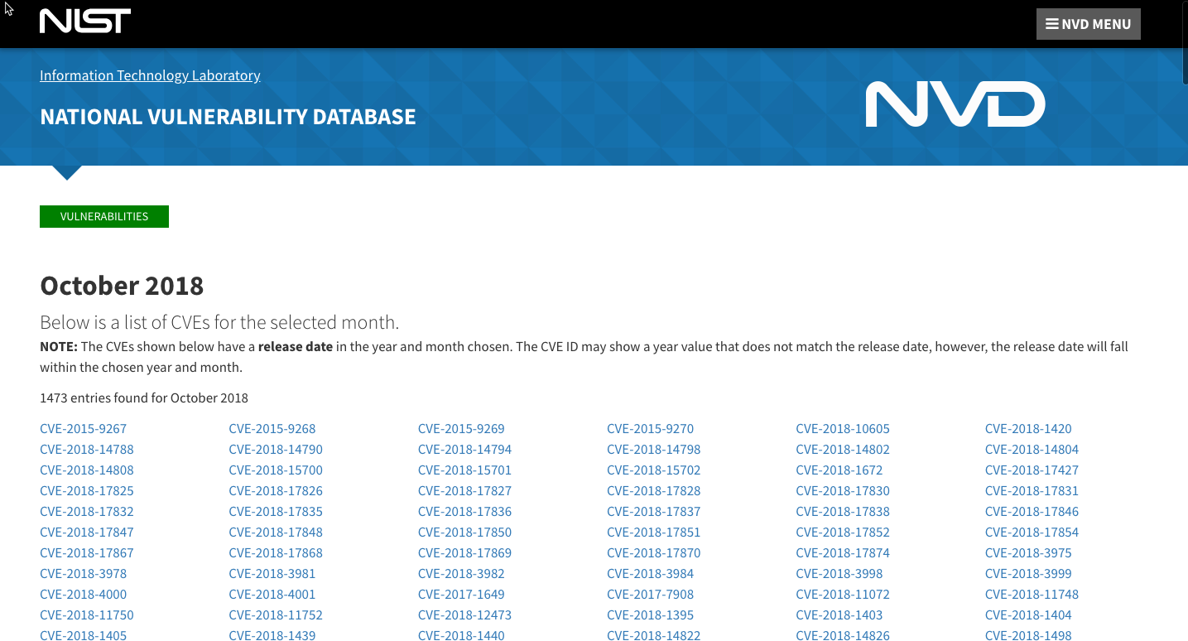
October 2018 - 1473 new so far
https://nvd.nist.gov/vuln/full-listing/2018/9
Notes:
At the time of slide creation 1032 vulnerabilities just for the month of September 2018.

Slide 36
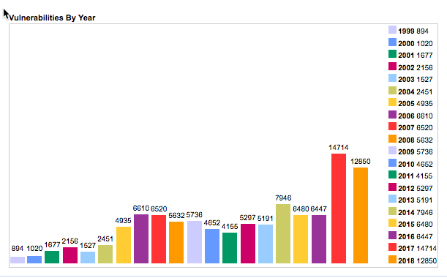
It seems that we are getting worse at security
https://www.cvedetails.com/browse-by-date.php
Notes:
Actually it is that there are more looking for vulnerabilities and more software usage in the world. Last year the total number of vulnerabilities was more than the first 6 yrs of tracking combined.
https://www.cvedetails.com/browse-by-date.php

Slide 37
Step 4:
is there any testing
the test
suite
Notes:
Another thing you can do if you’re just not sure about a project is to take a look at the test suite.

Slide 38
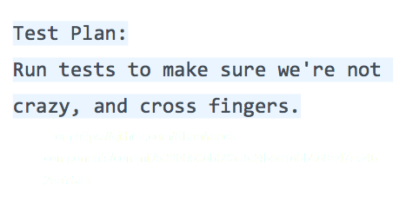
is there a Test suite
Notes:
So what do good and bad test suites look like? I was going to show some examples, but it got unreadable pretty quickly, so let’s just talk qualities. [Speaker will summarize from slide]

Slide 39
Key Questions about Test Suites
Testing isn’t the only thing we take into account, but it can be used as a rule of thumb if you don’t know security and want to guess at what might be a good library.
Does this test suite cover bad behaviour?
How comprehensive is this test suite?
Do all tests pass?
Is there continuous integration for tests?
Testing is especially important for libraries that handle user input: parsers, input validation libraries, etc. A poor test suite doesn’t guarantee a blacklisted component, but a good suite often implies a better choice.
Notes:
As before, here’s some key questions for folk who aren’t sure what a “good” test suite looks like. We’re looking for a good variety of tests covering good and bad behavior, and test suites are really important for things that parse user input.

Slide 40
Step 5:
Be aware
of
assumptions
Notes:
And finally, I want to take a moment to make sure you’re all aware of the type of assumptions we see that result in us making poor choices.
Good packages do not guarantee good dependencies

Slide 41
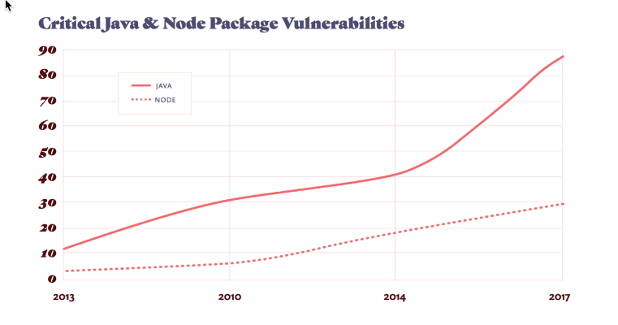
“90% of tested organizations use vulnerable dependencies."
- https://snyk.io/

Slide 42
Why?
Upstream projects do not use the same criteria for inclusion as Products should
It is possible for a package to depend on code that has vulnerabilities
Understand your dependencies and the additional risk it brings. Allocate time to work on the issues
Notes:
Why is this an issue? Remember that when you carefully vette an OSS component that you really need to be aware of what it depends on. Because when you bring that component into your project you will also be bringing anything it depends on too, good or bad.

Slide 43
all Repositories are not created equal
Npm (node.js), PyPi (python), ruby gems (ruby), CPAN (perl), etc. are not curated
Notes:
Anybody can create and check in to projects. Just because you have valid credentials to check in to a project does not mean you're a good guy.
Python Security - https://github.com/PyCQA/bandit
npm Security - https://github.com/i0natan/nodebestpractices#6-security-best-practices

Slide 44
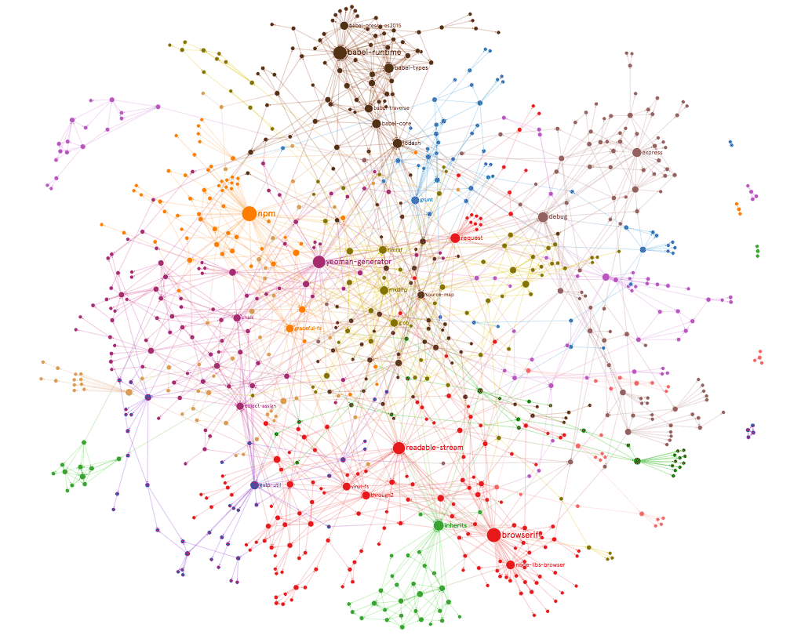
Package managers don’t always imply high quality
I wonder what happens when you remove a module?
Oh wait!! that already happened
Notes:
As seen in this chart of the npm tree of the first 4 levels of dependency shows that if you were to slip one module in there or even take one away you could wreak havoc
Oh wait!! that already happened

Slide 45
“How removing 11 lines of code nearly broke the internet”
A programmer named Azer Koçulu, during a trademark dispute, refused to change the name of his software module. Lawyers were able to get npm to give them rights to the module. In protest Koçulu removed his other code from npm, including something called npm left-pad which was used by thousands of projects.
“Popular software projects like Babel, which helps Facebook, Netflix, and Spotify run code faster and React, which helps developers build better interfaces, were suddenly broken and no more work could be done with them.”
Npm re-published the code, giving it to a new owner
Notes:
A related story about this is the “11 lines of code that nearly broke the Internet”
This is kind of a sad story about a guy whose open source project had the same name as something someone else had trademarked. When he refused to change the name of his already well-established project, the lawers got npm to give them rights to the name and thus trounced his work.
Upset, he pulled the rest of his code in protest, including software that was used by a bunch of big names, including Facebook and Netflix. All of a sudden, big popular projects were broken, and people were freaking out. Npm re-published his removed code and gave it to a new owner.
There’s two things you should worry about here: one, if there’s a trademark dispute on a name, code you’re using may suddenly be completely different code. And similarly, if a project becomes popular, it could be handed over to a new owner without consent or any warning. If you don’t verify the code you’re getting, you could seriously be getting anything, at any time, and not just if the developer decided to become malicious.

Slide 46
Bringing it all together
Notes:
Lot's of information presented very quickly. I will make this presentation available to all including the presenter notes. Let's take a look at what you should take away at the least.
Take a look (Are there red Flags?) Really Read it
Check for the number of contributors & activity
Does the project handle security issues
Look for a test suite (make sure it does something)
Be aware Trust nothing
Assumptions and poorly vetted software choices are common. By taking a little bit of time up front you can minimize the risk of using poorly managed open source.

Slide 47

Thank you
Type to enter a caption.
LinkedIn: https://www.linkedin.com/in/mikide/
Twitter: @theDawgCr8
Email: sec-princess@unroutable.me
Intel Credits: Terri Oda, Tiberius Heflin, John Anderson
https://github.com/sec-princess/Seagl-20181109
Notes:
LinkedIn: https://www.linkedin.com/in/mikide/
Twitter: @theDawgCr8
Email: sec-princess@unroutable.me
Resources:
https://github.com/sec-princess/Seagl-20181109
https://snyk.io
https://nvd.nist.gov/vuln/full-listing
https://www.cvedetails.com/

